Slide 1
Advanced Algorithms Session 8
Gorkem Kar
Notes:
The greedy approach II and Backtracking I
2433668
22666663

Slide 2

Contents
Review
Cryptology
The Huffman Code
The Greedy Approach vs DP
Intro to Backtracking
The n-Queens Problem

Slide 3

Cryptology
The study of techniques for secure communication
Cryptography: Securing information by encoding it
Cryptanalysis: Decoding encrypted info without access to the key

Slide 4
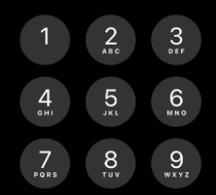
Encoding Using a Keypad
Not so efficient for “w, x, y, z” how many bits of information do you need?

Slide 5

Encoding Example
Given a code and a message it is easy to encode a message
If the code is
C1 = {a = 00, b = 01, c = 10, d = 11}
For the message: “bad”, we can encode it as:
010011

Slide 6
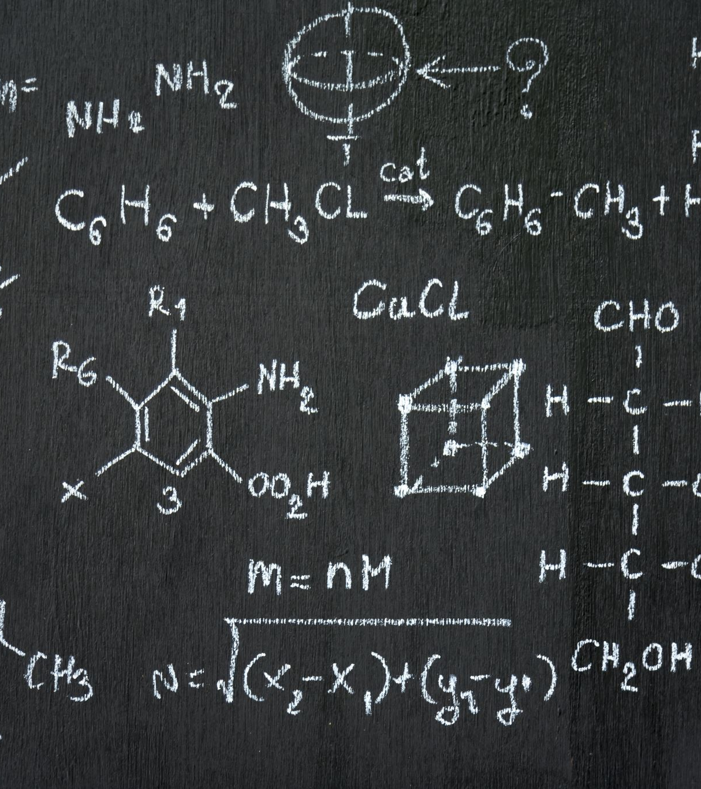
Decoding Example
Given the code C₂ = {a = 0, b = 110, c = 10, d = 111}
Received code = 1100111
The secret message
“bad”

Slide 7

Data Compression
Efficient data storage and transmission are crucial in secure communication
Data compression
Reducing the size of data to save storage space and bandwidth

Slide 8

Size Limitations
Suppose this message is to be sent over a network
BCAADDDCCACACAC
How many character are there?
15
Each character takes 8 bits
The total size?
8 * 15 = 120 bits

Slide 9

The Huffman Coding
It is a lossless data compression algorithm
Reduces the size of data, making it quicker to encrypt and transmit

Slide 10
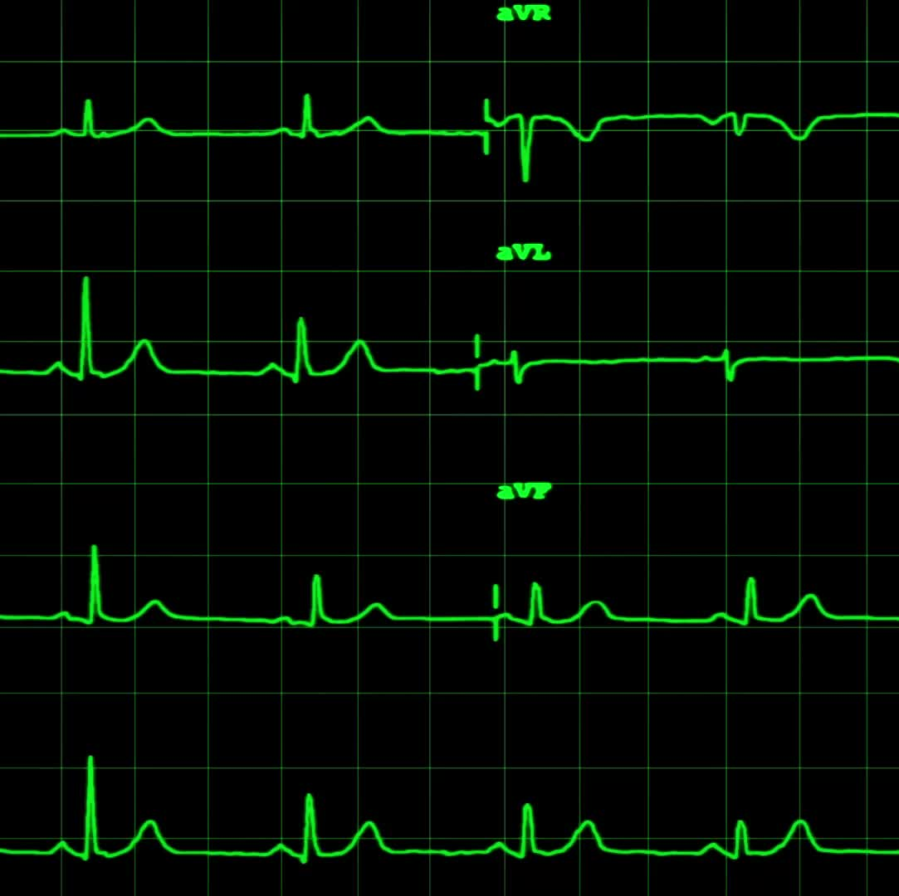
Huffman Coding - Construction
Frequency Analysis
Count the freq. of each character
Priority Queue Initialization
Each character will be a node with its freq.
Tree Construction
Extract the two nodes with lowest freq.
Create a new internal node with these two nodes as children and the sum of their freq. as the new node’s freq.
Result
The remaining node is the root of the Huffman tree

Slide 11

Huffman Coding – Encoding and Decoding
Encoding
Traverse the Huffman Tree to assign binary codes to each character
Left branch: 0, Right branch: 1
Decoding
Read the encoded bits and traverse the Huffman tree
Stop at leaf nodes to retrieve the original characters

Slide 12

Huffman Coding Video

Slide 13

Huffman Code Example
Let’s start with the keyword “Mississippi”
Which two letters will be combined first?
M and P
Then, we combine this newly created group with
S
Then, the newly created group will be combined with i
Notes:
Character Frequency
M 1
P 2
S 4
I 4

Slide 14

Huffman Code Exercise
The secret message has these characters and frequencies
Character Frequency
a 5
b 9
c 12
d 13
e 16
f 45
Notes:
Find the code for each character using Huffman Code.

Slide 15
Huffman Coding – Applications and Complexity
File compression: ZIP formats
Multimedia compression: JPEG, MP3
Data transmission:
Efficient encoding for faster transmission

Slide 16
Comparison
Greedy Algorithms
Make a series of locally optimal choices
Aim for a global optimum
Simple and efficient
Example:
Kruskal’s Algorithm
Prim’s Algorithm
Huffman Coding
DP
Solve problems by combining solutions to overlapping subproblems
Use a bottom-up approach to build the final solution
More complex, guaranteed to find the optimal solution
Examples:
Knapsack Problem
Fibonacci Sequence

Slide 17

Backtracking
Methodological way of trying various sequences of decisions
Until you find one that “works”
Incrementally build candidates for the solutions
Abandon a candidate (Backtrack) as soon as it is determined that it cannot lead to a valid solution

Slide 18
Backtracking
Choice
Constraints
Goal
Notes:
BONUS video: https://www.youtube.com/watch?v=Zq4upTEaQyM

Slide 19

Maze Problem
Notes:
https://www.youtube.com/watch?v=PwxGTHraMNg

Slide 20

Methods
Brute force
Try all possible solutions
Backtracking
Use a recursive function to explore all possible configurations
Prune branches that do not lead to a solution
Maybe also prune non-viable solutions early to reduce computation

Slide 21
The n-Queens Problem
Place n queens on an nxn chessboard so that no queens threaten each other
Queens can move horizontally, vertically, and diagonally
Constraints
No two queens can attack each other
How?

Slide 22
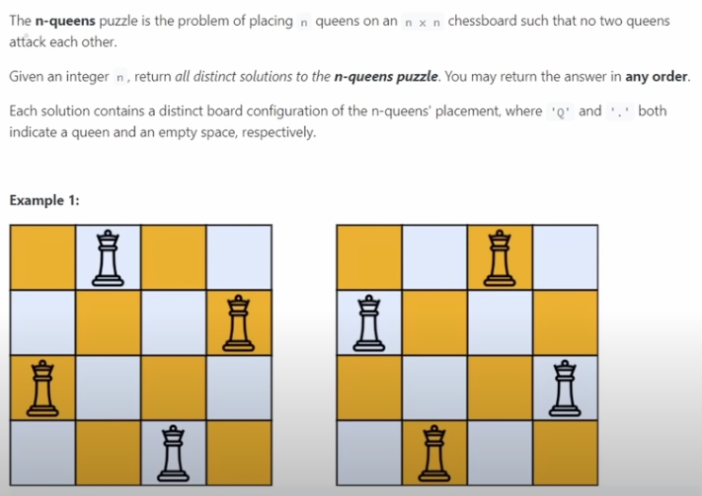
Sample Scenario
You might remember the leetcode site
Interview question
Notes:
Excellent video for discussion of N Queens problem: https://www.youtube.com/watch?v=wGbuCyNpxIg

Slide 23

Solution
Notes:
https://www.youtube.com/watch?v=Ph95IHmRp5M

